Slide 1
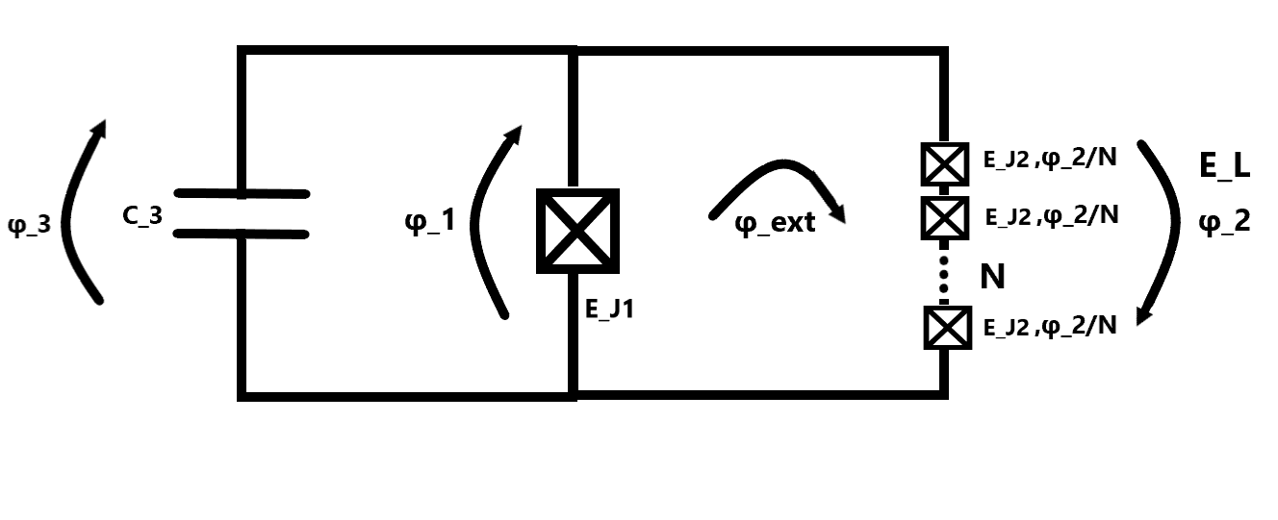
Fluxonium
31/5-2023 Group meeting
Amalie Paulsen

Slide 2
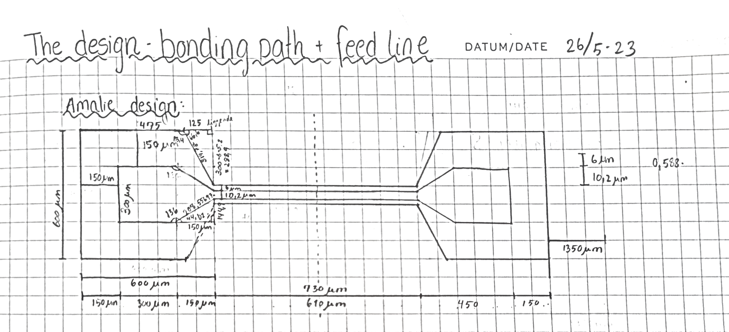
Currently doing
Next training is in SEM
A lot of computations
Making bonding pads in GDSPy

Slide 3
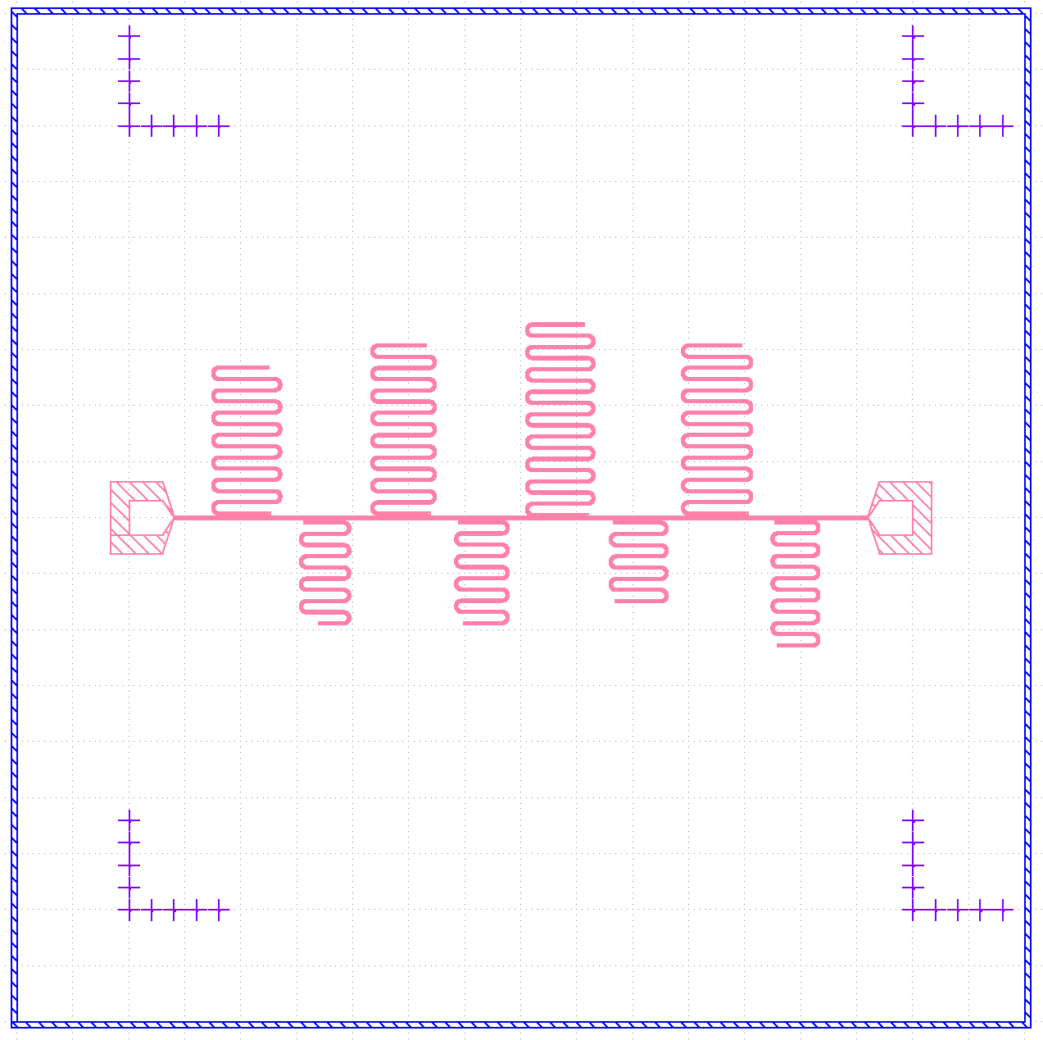
Resonators – Design
10x10 chip, 200nm Al, soft baked A4 resist, spun at 4000rpm for 1 min and baked at 115C for 2 min.
Perfect develop and etch

Slide 4
chip_1

Slide 5
chip_1

